Slide 1
BIOM 7110/8110 BIOSTATISTICS
Erno Lindner, Ph.D. (elindner@memphis.edu)
Amber Jennings, Ph.D.(jjnnings@memphis.edu)
M,W: 8:40-10:05
ecourseware

Slide 2
Experiments when each subject receives more than one treatment

Slide 3
Until now we discussed examples when the control and treatment group contained different subjects.
It is possible to design experiments in which each experimental subject can be observed before and after one or more treatments.
These are generally more sensitive because it can measure how the treatment effects each individual!
When a control and the treatment group consists of different individuals the changes due to the treatment may be masked by variability between the subjects.

Slide 4
The total variability in the observations :
Variability between the experimental subjects
Variability in the response by the different subjects
Variability due to treatment
Paired t test, in which the subjects are observed before and after they received a single treatment, reduces the variability due to the differences between the individuals and yields a more sensitive test.
Like all analysis of variance (including t test) the samples must be
random
normally distributed

Slide 5
The paired t test.
Experiments when each subject are observed before and after a single treatment.
We will test a hypothesis about the average change the treatment produces instead of the difference in the average responses with or without the treatment.
This approach reduces the variability in the observations due to differences between the individuals and yields a more sensitive test

Slide 6
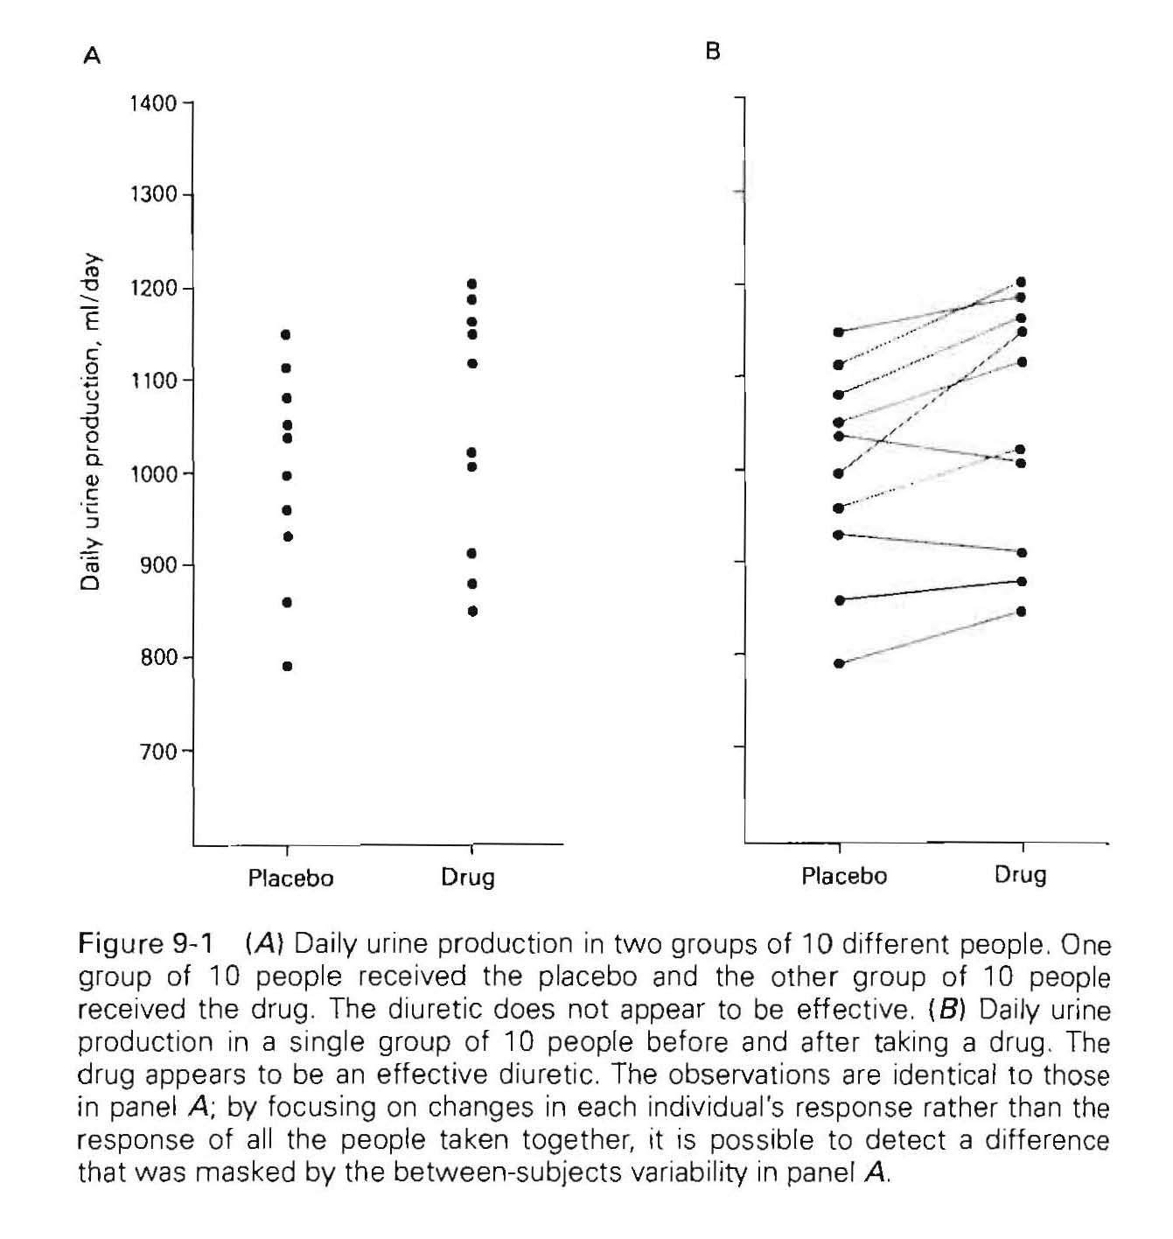
Placebo
Drug
t=1.33 (t_{0.05,DF=18}=2.101)
p=0.210
Drug increased the urine production in 8 of 10 people
Drug is an effective diuretic

Slide 7
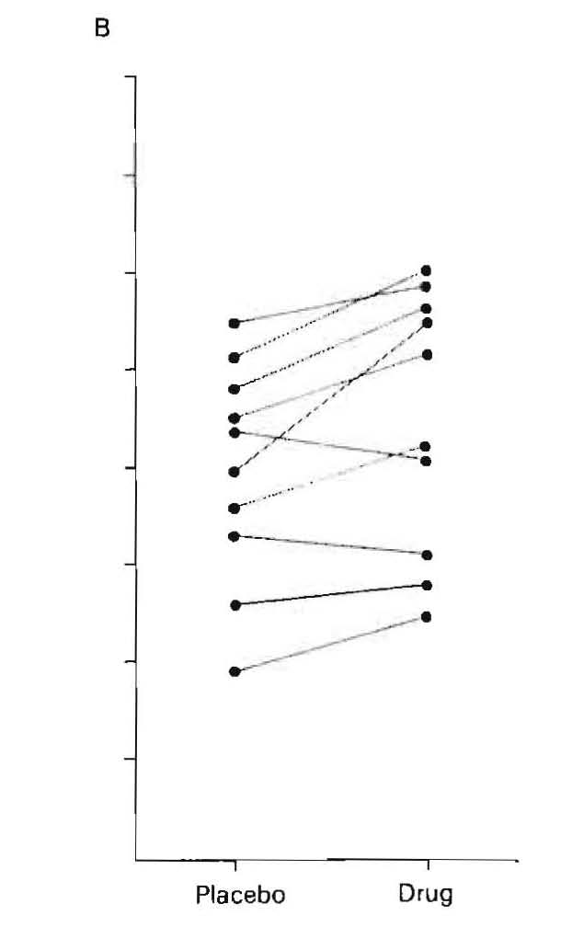
By concentrating on the CHANGE in each individual that accompanied the drug the effect could be detected that was masked by the variability between individuals.
To quantify our impression - perform paired t test.
Test that in average there is NO CHANGE
Definition of the t statistics

Slide 8
The parameter we wish to estimate is the average difference in response δ in each individual due to treatment.
If d is the observed change in each individual
is the mean change which can be used to estimate δ
The standard deviation of the observed differences is
So the standard error of the difference is

Slide 9
Therefore
To test the hypothesis of NO EFFECT set δ=0
The resulting t is compared to the critical value of t_{crit} with ν=n-1 degrees of freedom.

Slide 10
Summary of the protocol of evaluating data collected individuals before and after treatment
Compute the change in each individual in response to treatment (d)
Compute the mean change and the standard error of the mean changes
Use these numbers to compute
Compare this t with the critical value of t_{crit} for ν=n-1 degrees of freedom where n is the number of experimental subjects

Slide 11
Note:
DF ( ν) associated with the paired t test is LESS than the
2(n-1) DF associated with analyzing the same data using an unpaired t test.
The loss of DF increases the critical value of t that must be exceeded to reject the NULL HYPOTHESIS of no difference.
However, this loss of degree of freedom is almost always more than compensated for by focusing on the difference within the subjects.
The paired t test are almost always more powerful for detecting effects than the unpaired t test.

Slide 12
Example:
Smokers are more likely to develop diseases caused by abnormal blood clots (thromboses). Blood clots are related to platelets in the blood. To test the effect of smoking on undesirable blood clot formation the extent of the aggregation of platelets was measured by 11 individuals before and after they smoke a single cigarette. The aggregation was measured following a standard stimulus (the addition of ADP to the blood samples drawn from the test subjects. ADP makes the platelets to stick together).

Slide 13
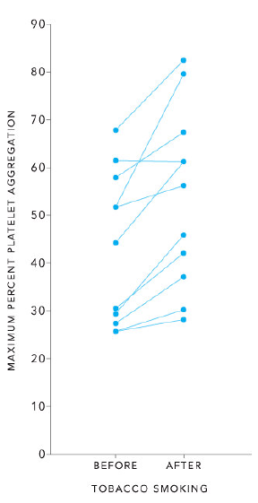
Average_{before}=(43.1±15.9)%
Average_{after}=(53.5 ±18.7)%
This approach omits the important fact about the experiment that the platelet aggregations were NOT measured in two different groups of people (smokers and not smokers) but in a single group of people who were observes before and after smoking

Slide 14
Average_{before}=(43.1±15.9)%
Average_{after}=(53.5 ±18.7)%
In all but one individual the platelet aggregation increased after one cigarette
The large variability in platelet aggregation between individuals masked the variability related to smoking.
Taking into account that the data represent pairs of observations (measured before and after) we can focus on the CHANGE.

Slide 15
Average_{before}=43.1±15.9%
Average_{after}=53.5 ±18.7 %
Change (%)
2
4
10
12
16
15
4
27
9
-1
15
t_{crit,0.05, 10}=2.228
t_{crit,0.01, 10}=3.17
t_{crit,0.05, 20}=2.086
P=0.0016

Slide 16
How convincing is that the effect is related to tobacco smoke (nicotine), as opposed to other chemicals common to smoke in (e.g., CO) or even stress of the experiment produced?
Let the same subjects to
Smoke an unlit cigarette
Smoke nicotine free cigarette (lettuce leaf)

Slide 17
No effect
No effect
Significant increase
In well designed experiment, the only difference between the treatment group and the control group, both chosen at random from the population of interest, is the treatment.

Slide 18
Ginkgo is widely cultivated tree in China. Extracts of ginkgo leaves have been used pharmaceutically. Ginkgo is believed to be moderately effective in improving cognition in dementia patients.
Evaluate as two sample t test and as before and after t test
sample # | mem. Scr. Pre | mem scr. Post
1 | 73 | 76
2 | 55 | 58
3 | 73 | 73
4 | 58 | 60
5 | 54 | 60
6 | 56 | 63
7 | 60 | 55
8 | 74 | 77
9 | 76 | 84
10 | 62 | 75
11 | 59 | 68
12 | 54 | 53
13 | 60 | 66
14 | 67 | 72
15 | 62 | 56
16 | 61 | 67
17 | 67 | 66
18 | 56 | 59
19 | 77 | 83
20 | 69 | 71
21 | 64 | 64
22 | 44 | 46
23 | 59 | 59
24 | 67 | 67
25 | 52 | 54
26 | 63 | 74
27 | 64 | 71
28 | 56 | 56
29 | 76 | 81
30 | 69 | 68
Shapiro Wilk
test
 | Mem. Score. Pre |  | Mem. Score post
W | 0.969404 |  | 0.98196
p-value | 0.52301 |  | 0.874932
alpha | 0.05 |  | 0.05
normal | yes |  | yes

Slide 19
Ginkgo is widely cultivated tree in China. Extracts of ginkgo leaves have been used pharmaceutically. Ginkgo is believed to be moderately effective in improving cognition in dementia patients.
EQUAL VARIANCE TEST
sample # | mem. Scr. Pre | mem scr. Post
1 | 73 | 76
2 | 55 | 58
3 | 73 | 73
4 | 58 | 60
5 | 54 | 60
6 | 56 | 63
7 | 60 | 55
8 | 74 | 77
9 | 76 | 84
10 | 62 | 75
11 | 59 | 68
12 | 54 | 53
13 | 60 | 66
14 | 67 | 72
15 | 62 | 56
16 | 61 | 67
17 | 67 | 66
18 | 56 | 59
19 | 77 | 83
20 | 69 | 71
21 | 64 | 64
22 | 44 | 46
23 | 59 | 59
24 | 67 | 67
25 | 52 | 54
26 | 63 | 74
27 | 64 | 71
28 | 56 | 56
29 | 76 | 81
30 | 69 | 68
VR | 1.375
VR(Crit) | 1.861
p | 0.198
t-Test: Two-Sample Assuming Equal Variances
t | 1.386
t (crit) | 2.002
p | 0.171

Slide 20
Ginkgo is widely cultivated tree in China. Extracts of ginkgo leaves have been used pharmaceutically. Ginkgo is believed to be moderately effective in improving cognition in dementia patients.
Evaluate as two sample t test and as before and after t test
sample # | mem. Scr. Pre | mem scr. Post
1 | 73 | 76
2 | 55 | 58
3 | 73 | 73
4 | 58 | 60
5 | 54 | 60
6 | 56 | 63
7 | 60 | 55
8 | 74 | 77
9 | 76 | 84
10 | 62 | 75
11 | 59 | 68
12 | 54 | 53
13 | 60 | 66
14 | 67 | 72
15 | 62 | 56
16 | 61 | 67
17 | 67 | 66
18 | 56 | 59
19 | 77 | 83
20 | 69 | 71
21 | 64 | 64
22 | 44 | 46
23 | 59 | 59
24 | 67 | 67
25 | 52 | 54
26 | 63 | 74
27 | 64 | 71
28 | 56 | 56
29 | 76 | 81
30 | 69 | 68
mem. Scr.Diff
3
3
0
2
6
7
-5
3
8
13
9
-1
6
5
-6
6
-1
3
6
2
0
2
0
0
2
11
7
0
5
-1
Memory score differences
mean | 3.2
std dev | 4.3
median | 3.0
n | 30

Slide 21
Expected/predicted difference if no effect δ=0
Assumption: Unbiased random sampling; normally distributed data (Box plot: symmetrical, mean=median, no outliers, n=30 – based on CLT can assume normal distribution)
Memory score differences
mean | 3.2
std dev | 4.3
median | 3.0
n | 30
DF=n-1=29
p<0.0005 (TDIST_{4.05,29,2}=0.000349)
t_{crit}=2.045 (TINV_{0.05,29})
Interpret: There is a significant difference in the memory scors.

